Slide 1


Welcome to our SEND coffee morning

Slide 2

What is the purpose of a coffee morning?
Providing a supportive environment for parents and carers of SEND children to relax and talk with others.
Providing parents and carers with information regarding local services and advice on how to support your child.

Slide 3
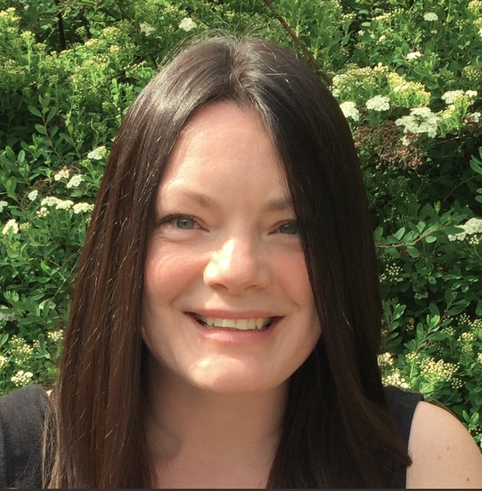
Meet the new SENCO
Mrs Anna Bayes
SENCO with 5 ½ years of experience
In every Friday for the full day.
Please feel free to make an appointment via the school office if you would like to discuss your child's needs.

Slide 4


Slide 5


Slide 6


Slide 7


Slide 8


Slide 9



Slide 10

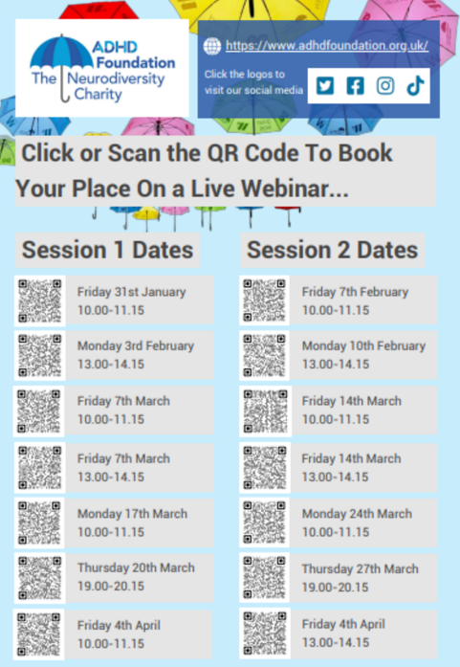

Slide 11

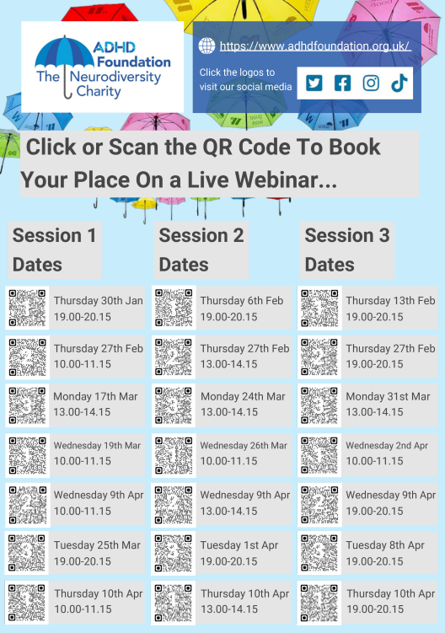

Slide 12


Slide 13


