Slide 1

Calculation Policy
Sedgeberrow C of E First School
Updated September 2019

Slide 2
Calculation Policy
This policy has been devised to give children a consistent and smooth progression of learning in calculations.
The calculation policy is organised according to age stage expectations as set out in the National Curriculum 2014, however, it is vital that pupils are taught according to the stage that they are currently working at, being moved onto the next level or building their confidence by working at a lower age stage. There is also the opportunity to add steps to suit the children’s needs.
It is important that any type of calculation is given a real life context or problem solving approach to enhance their understanding of the purpose of the calculation.

Slide 3
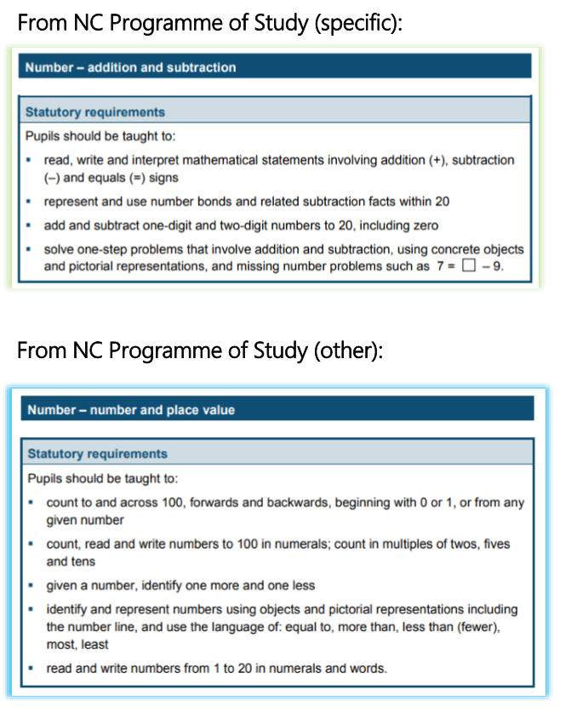
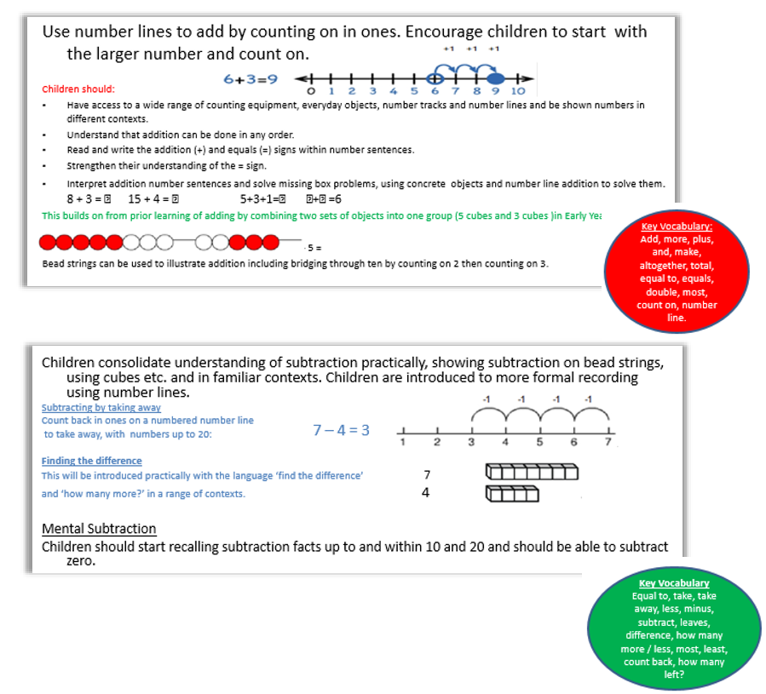
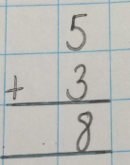
Year 1
Addition and Subtraction
By the end of Year 1 introduce the column method with 1 digit numbers.

Slide 4
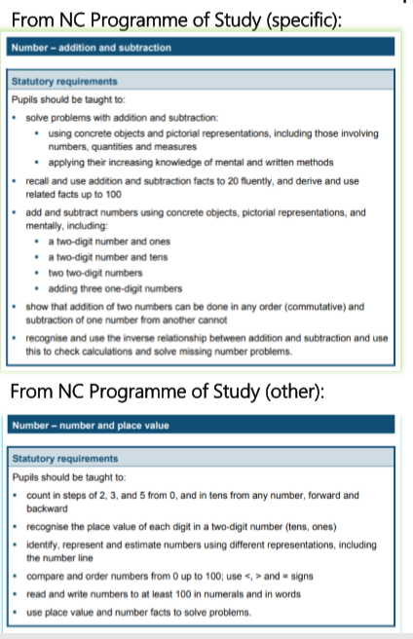
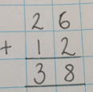
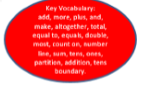
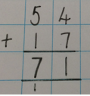
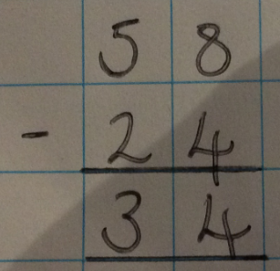
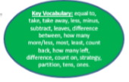
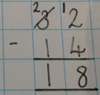
Year 2
Addition and Subtraction
Addition
2 digit and 1 digit numbers
Children develop mental fluency with addition and place value. When adding a 1 digit number to a 2 digit number they count on in their head.
32 + 4 =
32 in your head and count on 4.
Children also have quick recall of number facts and know 2 + 4 = 6 so it is 36.
2 digit numbers
The compact column methods are taught. Step 1 - with no exchanging:
Step 2 - introduce exchanging when the children are secure in place value:
Subtraction
2 digit and 1 digit numbers
When subtracting a 1 digit number from a 2 digit they count back. 48 – 5 =, 48 in your head and count back 5.
2 digit numbers
The compact column methods are taught. Step 1 – with no exchanging:
Step 2 – Introduce exchanging when the children are secure:

Slide 5
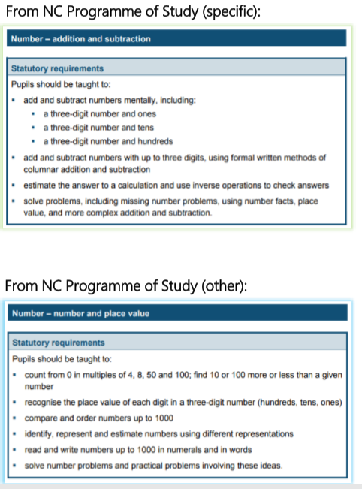
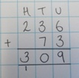

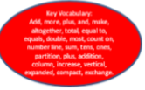
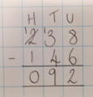
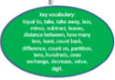
Year 3
Addition and Subtraction
Addition
Continue to develop column addition.
Step 1 - Move to 3 digit numbers.
Step 2 – Add money where only one exchange is required.
Subtraction
Continue to develop the column method. When subtracting involving exchanging explore partitioning in different ways so the children understand the value is the same. For example, 57 = 50 + 7 = 40 + 17 = 30 + 27 etc.
Once children are secure with subtracting requiring one exchange
extend to more than one exchange:

Slide 6
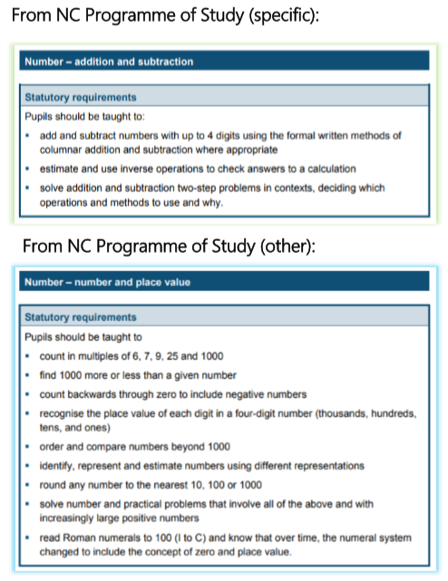
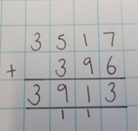
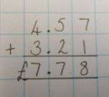
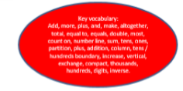
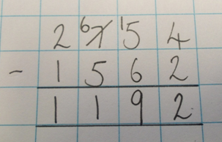
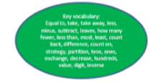
Year 4
Addition and Subtraction
Addition
Continue to develop the column method using larger numbers and also ensure that the children are given questions involving money and measures.
Subtraction
Reinforce the column method but move towards more complex numbers which involve more exchanging.
Ensure that questions involve different contexts to include money and measure.

Slide 7
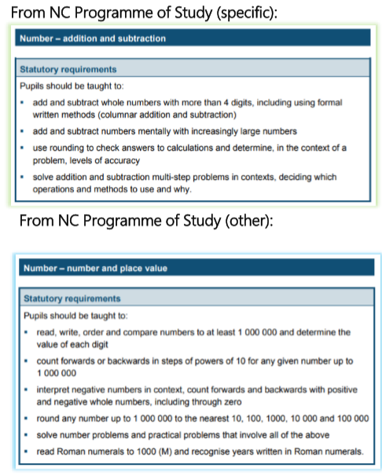
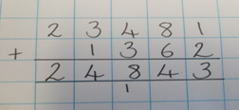
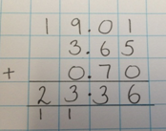

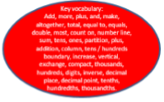
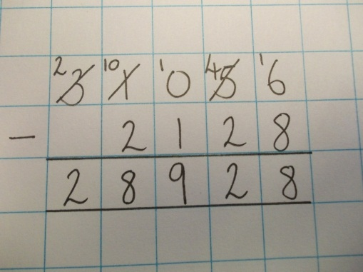
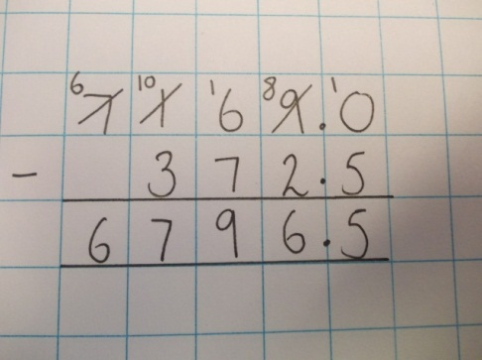
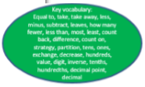
Year 5
Addition and Subtraction
Addition
Children will add using numbers exceeding 4 digits.
Children will add using money, measure and decimals. They will carefully align the place value columns.
Subtraction
Column subtraction with larger numbers
and where multiple exchanges are required.
Subtract with decimal values, including mixtures
of integers and decimals, aligning the decimal
point.

Slide 8
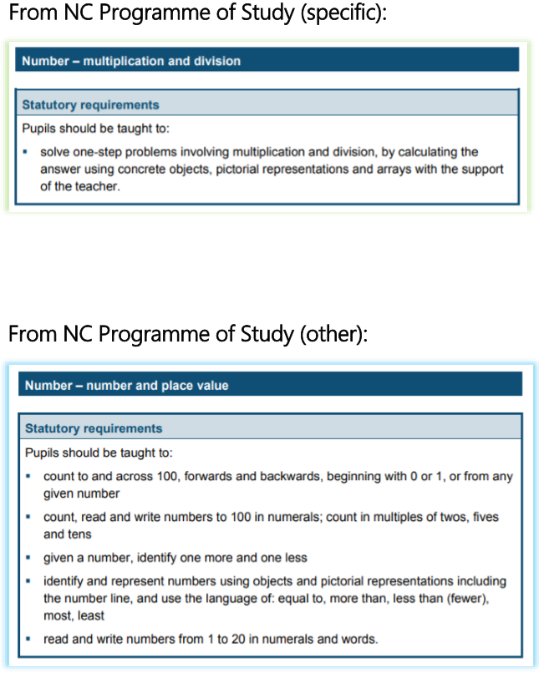
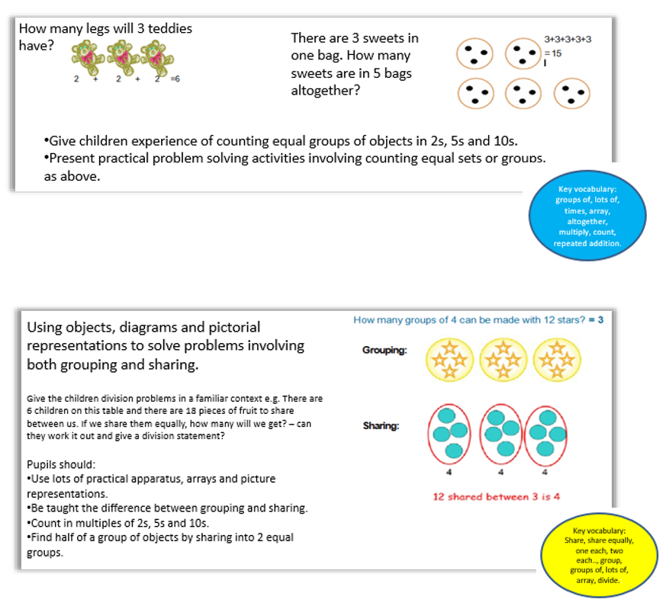
Year 1
Multiplication and Division

Slide 9
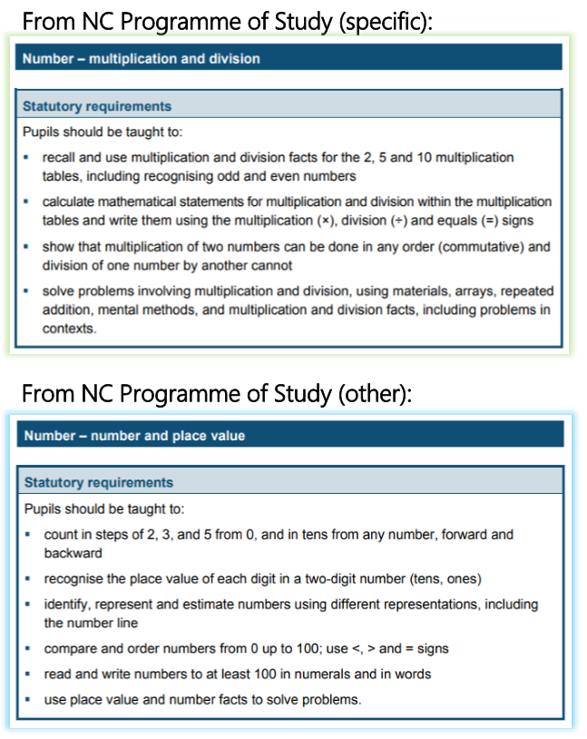
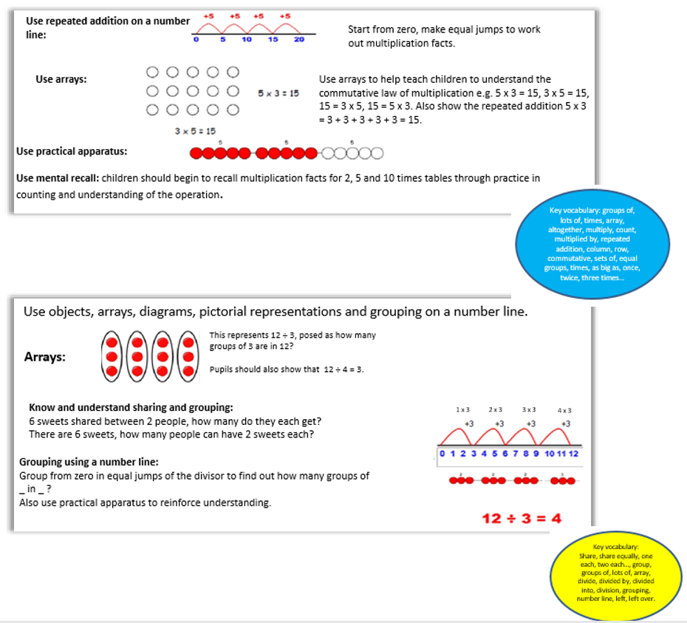
Year 2
Multiplication and Division
Once children are confident move to quick recall of the multiplication and division facts.

Slide 10
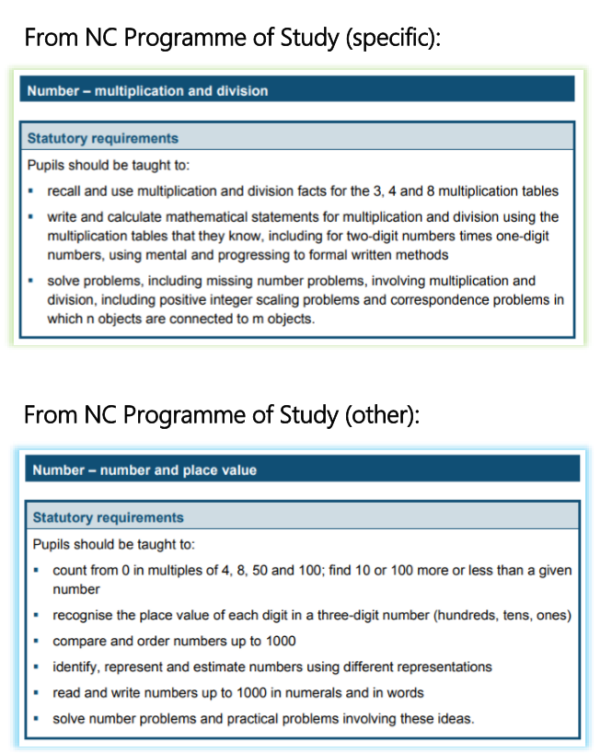
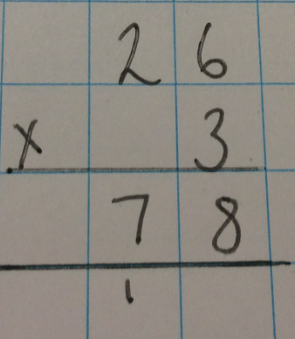
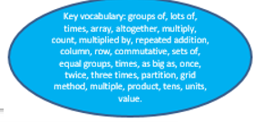


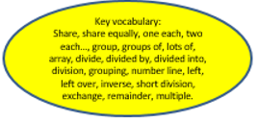
Year 3
Multiplication and Division
Multiplication
Children become fluent working out multiplication facts using mental strategies and arrays if needed. Focus is on learning the multiplication facts.
Children are introduced to the short method
of multiplication when multiplying by a 1 digit number.
Division
Children are now also taught remainders.
Step 1 - Children are introduced to the short method of division.
Step 2 – Children are then taught how to carry the remainder
onto the next digit.
All children given opportunities to apply these to real life contexts.

Slide 11
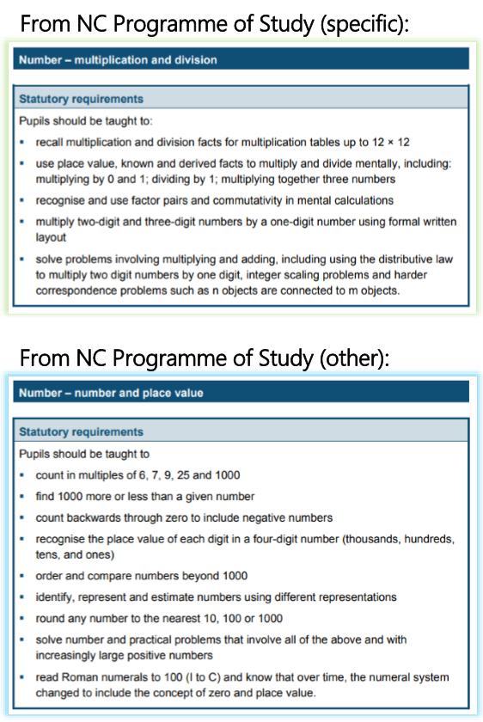
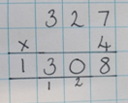
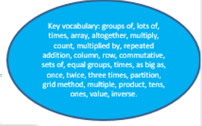


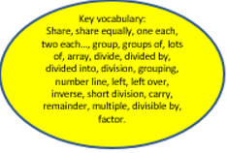
Year 4
Multiplication and Division
Multiplication
Children are taught to multiply 2 and 3 digits by a single digit.
They continue to use the short column multiplication method.
Division
Children continue to use the short division method.
They continue to calculate divisions with remainders.
Next step – divide numbers with up to 3 digits by 1 digit.

Slide 12
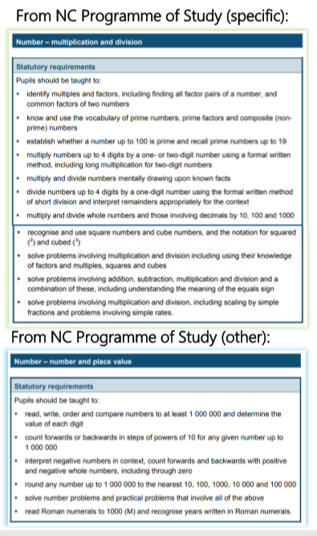
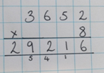
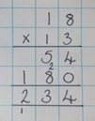
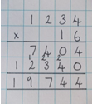
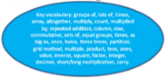



Year 5
Multiplication and Division
Multiplication
Children are taught to multiply up to 4 digits by 1 and 2 digits.
Short multiplication for multiplying by a single digit.
Long multiplication for multiplying by 2-digits.
Division
Children are taught to divide using remainders and can express the remainder in the correct context of the question.
Short division is used for dividing by a single digit.
Long division is used for dividing by 2 digits.

